Slide 1
Systems Failures Methodology Information Systems in Organizational Design and Applied System Thinking Melih SARIAYAN

Slide 2
Objectives
Revisit the concept of “Systems Failures”
Describe the System Failure methodology
Illustrate the stages of the methodology
Introduce comparison techniques

Slide 3
Introduction
Systems failure methodology
Provides a disciplined way of examining “failures”
Enables to gain understanding of situations
Enables to draw lessons for preventing similar failures

Slide 4
Introduction
Essence of Systems failures methodology ; Comparison between apparent failure situation and a range of paradigms.

Slide 5
System Failures Methodology
System Failures Paradigms
Formal system
Control
Communication
Engineering reliability
Human factors
Forecasting and planning

Slide 6
System Failures Methodology
Some paradigms(control,communication) are desirable wheras others(fault trees and cascades) are undesirable.
The point:
Think about what to do
Pay attention to resources
There are several stages of the methodology.

Slide 7
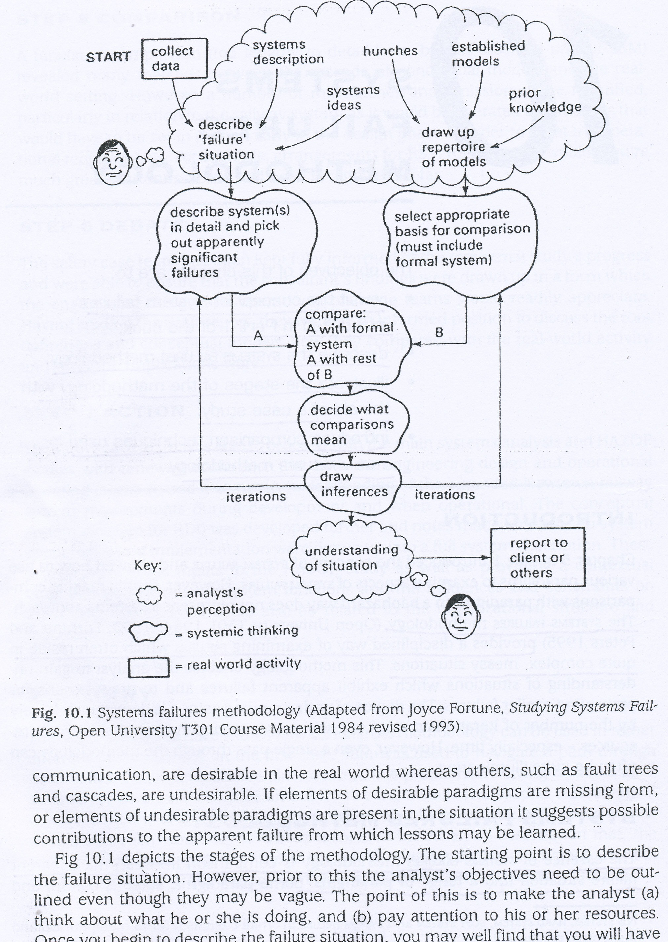
System Failures Methodology

Slide 8
Describing the Failure Situation
Search for evidence that someone at least is dissatisfied with the performance
Collect data
Interviews
Visit places
System logs
Brainstorm
Do not use the term of ‘failure’, use ‘problem’ or ‘difficulties’
A rich picture can be useful to draw failure situation

Slide 9
Describing the Failure Situation
Take a key system and describe it in detail.
Describe failure situation by considering:
Components
Inputs and Outputs
Environment
Structure
Variables and their relationships
Significant failures
Appropriate paradigms

Slide 10
Describing the Failure Situation
Seperate the system into components
Check
Missing components
Differences between component resolution
Missing relations between components
Relations between components and environment

Slide 11
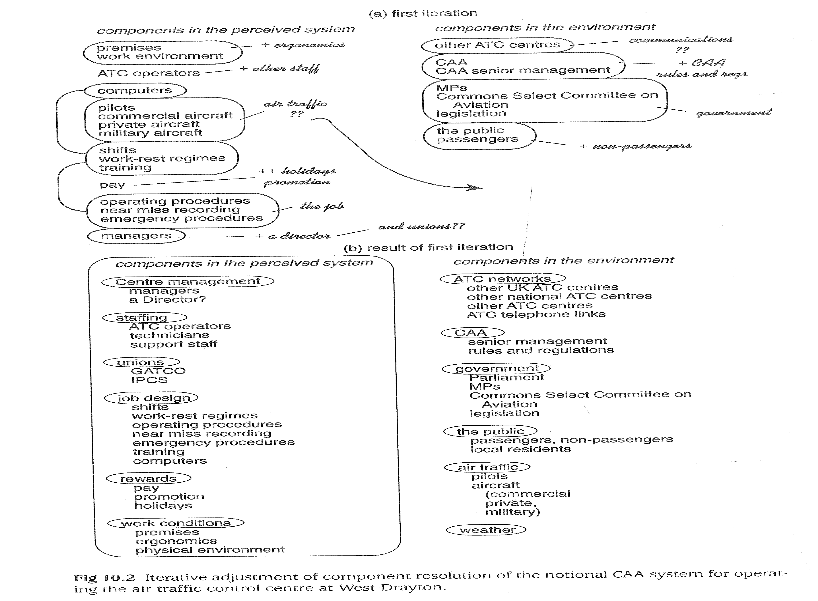

Slide 12
Describing the Failure Situation
List inputs, outputs and enviroment
Adjust resolution of input and outputs
Missing inputs or Unwanted outputs?
Find outside enviroment components
Extract the structure by looking for subsystems
Decision Making
Monitoring
Control
Operational

Slide 13
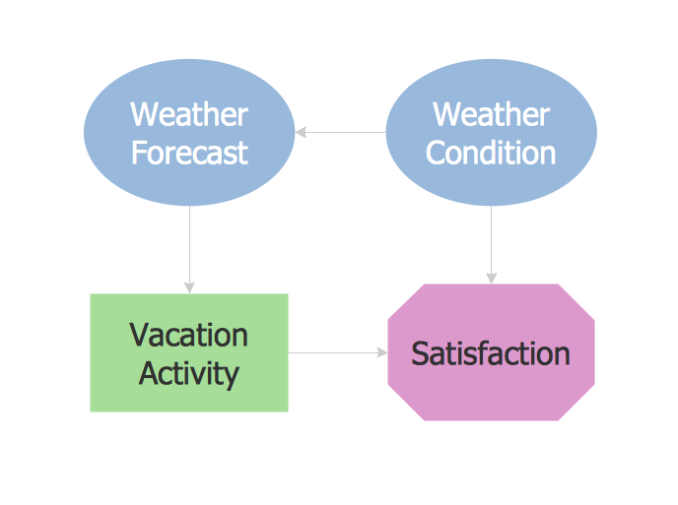
Describing the Failure Situation
List variables by using influence diagrams

Slide 14
Describing the Failure Situation
Apparently Significant Failures
Consider apparent failures which occured in different phases of life
Categorize apparent failures according to the functions or subsystems

Slide 15
Describing the Failure Situation
Choose paradigms
Formal system paradigm is a necessary model to select for comparison
Based on the failure type and categorization, best suitable paradigm should be selected.
Equipment failure: Fault Tree/Cascade
Monitoring failure: Control

Slide 16
Comparison with paradigms
Select a number of
Apperantly significant failures
Corresponding paradigms for comparison
Template diagrams of paradigms with the corresponding failure situation

Slide 17
What do comparisons mean?
First, compare appreant failure with formal system paradigm
Since formal system paradigm incorporates the fundamental elements:
Control
Monitor
Communication
Then use other paradigms

Slide 18
What do comparisons mean?
A simple 2X2 table is useful for aiding interpretation
Combinations in 1 and 4 may represent an acceptable situation
Paradigm
 | Desirable | Undesirable
No/few discrepancies | 1 | 2
Many discrepancies | 3 | 4
Contingency table for interpreting paradigm comparisons

Slide 19
What do comparisons mean?
Sometimes it is not possible to allocate an interpretation to one quadrant
Example: Communication failures
Message was received and understood
Message was not acted upon expected
Float between quadrants 1 and 3 until clarification

Slide 20
Learning
Aim: Summarize what you have learned from failure study
Understanding;
Enables preventive actions or treatments
Points to the other studies SSM or hard systems

Slide 21
Learning
Decide;
Whether further investigation is needed
Whether resources and time are available for this
Further iterations include
Internal checks on
Refinements , Identification and Analysis of key systems

Slide 22
Learning
The 4 Keys to Learning From Failure*
Reevaluate your planning
Reevaluate your preparation
Reevaluate your execution
Focus on variables in your control
*http://www.huffingtonpost.com/guy-winch-phd/learning-from-failure_b_4037147.html

Slide 23
Summary
System failure methodology enables the analyst to gain understanding about complex situations
Analysts or others can identify possible preventive actions to the failures
Methodology also provides a disciplined approach to compare key systems with the paradigms

Slide 24
Thank you for your listening☺

